Slide 1
JDemetra+ an open framework for seasonal adjustment and time series methods for official statistics
ESTP training

Slide 2
Outline
Objectives of JDemetra+ (JD+)
General
For seasonal adjustment (SA)
What is really JD+ ?
Architecture, design
Seasonal adjustment framework
Overview, pre-processing, decomposition
State space framework
Goals, overview
Some examples
Final remarks

Slide 3
General Objectives
Providing algorithms for the production/analysis of [official] statistics
Regular time series (from monthly to yearly)
Algorithms for
Seasonal adjustment, business cycle analysis
Benchmarking, temporal disaggregation
Modelling (forecasting, estimation of missing values, outliers detection)
Reusable modules, compatible with common IT infrastructure
Java, WEB services...
Designed for the whole statistical process
From research to bulk production (flexible, high-performance)
Maintainable
Open source solution

Slide 4
Objectives for SA
Java implementation of the leading algorithms
Tramo-Seats, X12-ARIMA...
Flexible design
Easier modifications of the core engines
Developments of additional tools/algorithms
Challenge
Keeping
similar results
high performances
with
flexible (more general) design and algorithms
slower technical solution

Slide 5
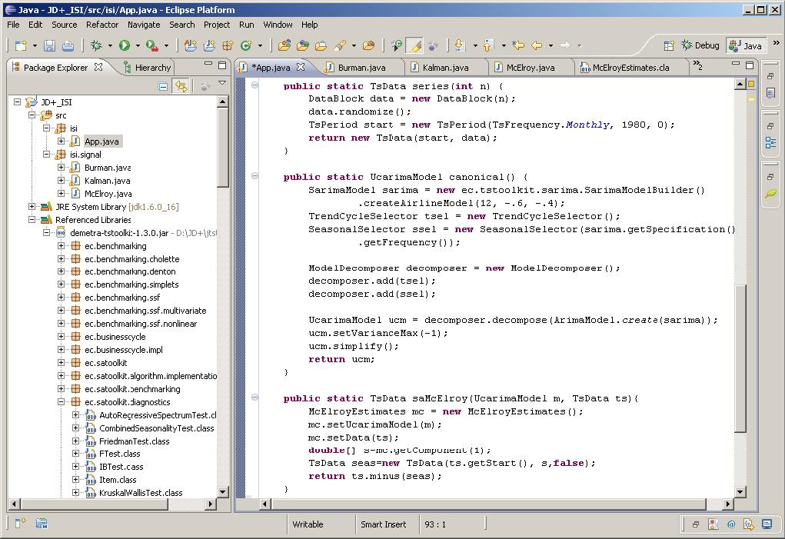
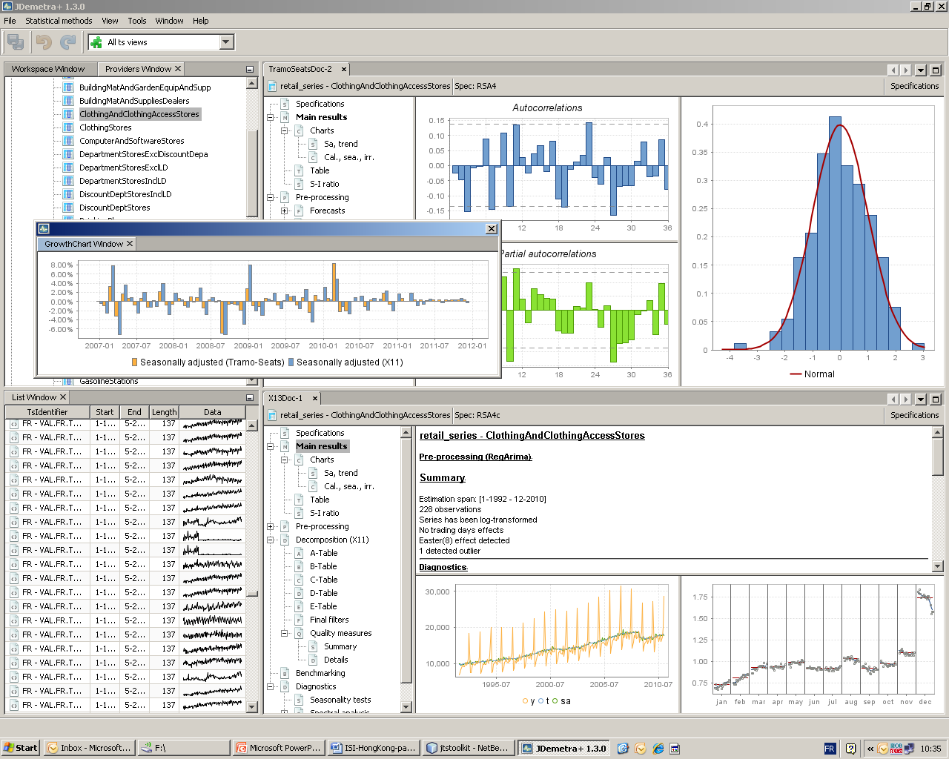
What is JD+ (I) ?
Advanced Java toolkit for time series (SA) processing (IT-teams, researchers)
Rich graphical application (end-users)

Slide 6
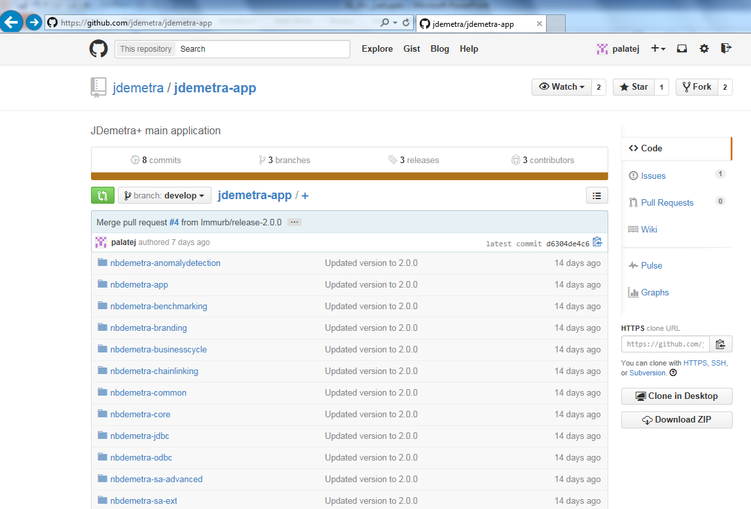
What is JD+ ? (II)
Open Source project
(EUPL license)
Supported by Eurostat
Developers:
NBB
Bundesbank
...
Originally based on:
Tramo-Seats (BDE)
X12-Arima (USCB)
https://github.com/jdemetra

Slide 7
Architecture (I)
JTsToolkit
Core algorithms
In house developments
Cruncher
External
packages
Peripheral modules
Jdemetra-core
Jdemetra-app
NetBeans
JDemetra+ plug-ins
Third party
plug-ins

Slide 8
Architecture (II). Algorithmic libraries
Basic data handling
Basic econometrics
Tramo
Benchmarking, temporal disaggregation
Matrix computation
Arima modelling
RegArima
Complex, polynomials
Structural models...
VAR,
Dynamic factor model
Linear filters
Seasonal adjustment
X11
Seats
High frequency
Function optimization
Arima, Ucarima
STL
Revisions analysis
Basic statistics
Utilities...
State space framework
Time series, calendars, regression variables...

Slide 9
Seasonal adjustment framework
Generic modules:
Analysis
Seasonality tests
Revision analysis
Sliding spans
I/O (common xml schema)
Graphical components
Charts
SI ratios...
SA methods
Specific modules
(X11...)
Tramo-Seats, X12-Arima...
REGARIMA modules:
Common model
Estimation tools
Automatic modelling routines
Analysis tools (residuals, forecasts...)
Graphical components
REGARIMA pre-processing
Other filters (X11...)
Model-based decomposition
(canonical decomposition,
structural models...)
Signal extraction tools:
Estimation
Analysis
Graphical components

Slide 10
REGARIMA modelling
Model building
(Reg. variables)
Common definitions for Calendar variables, outliers, intervention variables, user variables...
Algorithms for likelihood estimation
Kalman filter (Tramo-like),
Ansley algorithm (Cholesky on banded matrix)
(modified) Ljung-Box algorithm (X12-like)
Equivalent results, different performances
JD+ uses Kalman filter
Up to 4 x faster than Ljung-Box
Ansley in specific cases (outliers detection)
Optimization procedure
Levenberg-Marquardt. Tramo-Seats, X12 and JD+ use slightly different variants.
Estimation of the model
(likelihood, residuals)
Estimation of the parameters (by ML)

Slide 11
Final remarks
JD+ is a complete re-factoring of Tramo-Seats an of X12-Arima in an open OO framework. In some cases, the new algorithms may lead to (usually slightly) different results .
JD+ is also designed for the handling of related time series problems, especially through a rich state space library.
By developing it as an open source solution, we have tried to create an environment appropriate to external collaborations.

